Slide 1
Introduction to VVUQ | Part 1 Simulation Credibility Assessment
Task Group on VVUQ Concepts in Engineering Education
ASME Codes & Standards | Committee on Verification, Validation, and Uncertainty Quantification
Contacts: Lydia Stanford (stanfordl@asme.org) | Daniel Papert (papertd@asme.org​)
V. 1, February 11, 2025
© 2025 by ASME Task Group on VVUQ in Engineering Education is licensed under CC BY 4.0. To view a copy of this license, visit https://creativecommons.org/licenses/by/4.0/

Slide 2
Outline
Why do we care?
Structure of a simulation model
How is a simulation model assessed?
How is simulation credibility assessed?
Context of use of the simulation
v. 1, February 11, 2025

Slide 3
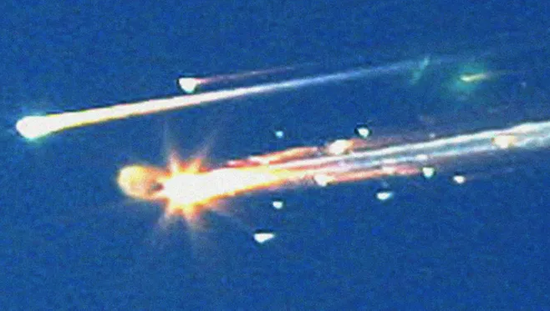
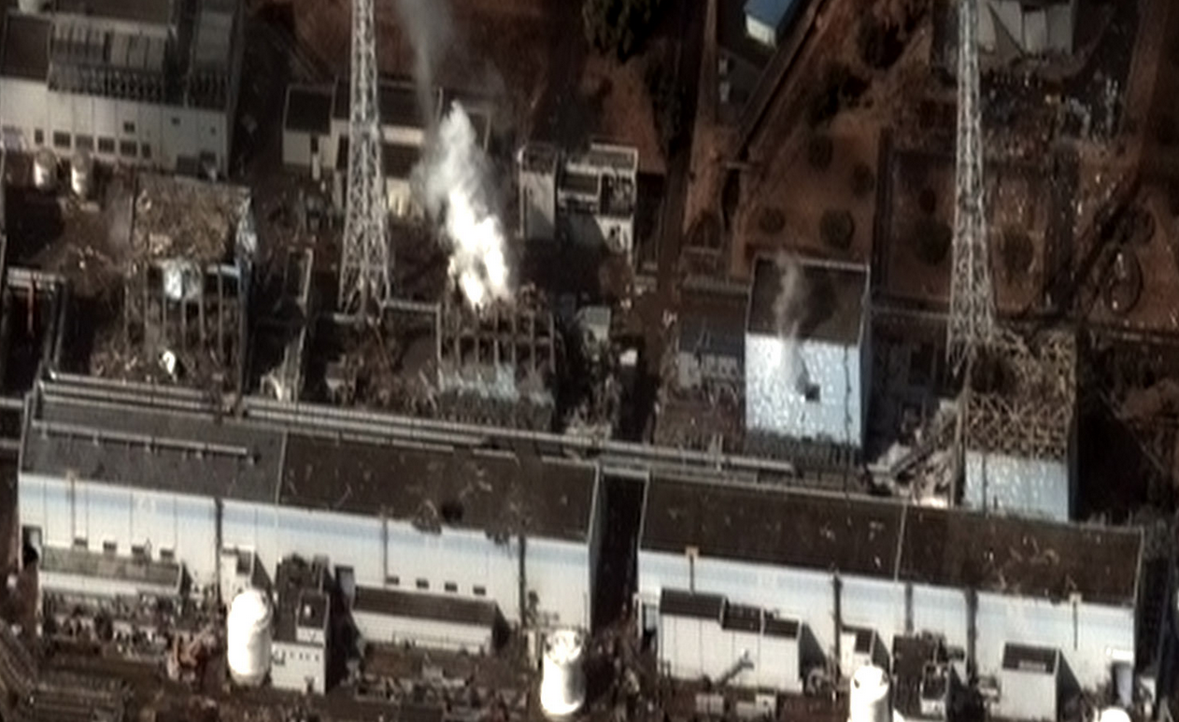
Why do we care?
“All models are wrong – some are useful.” – Prof. George E. P. Box
Why is this true?
All models rely on assumptions and approximations in the formulation of the model
All models require input data to describe the system of interest and its surroundings, which are approximate or possibly not measurable
All models require numerical solution, which results in numerical errors
Infamous system failures due to erroneous modeling:
v. 1, February 11, 2025
Space Shuttle Columbia Disaster
Fukushima Nuclear Disaster

Slide 4
Structure of a simulation model
Conceptual modeling assumptions and approximations in the formulation of the model input data
Conceptual modeling assumptions and approximations in the formulation of the mathematical model
Model Input Data
$x_{i}$ $i=1,2,…,N$
$$x_{i}$$
Mathematical Model
$$f\left(x_{i}\right)$$
$$y_{j}$$
Model Output Data
$y_{j}$ $j=1,2,…,M$
Examples of model input data:
System mass
System geometry
Thermal conductivity
Young’s modulus
System initial conditions
External loading
Magnetic field intensity
Acoustic environment
Examples of mathematical models:
Nonlinear algebraic equation
Ordinary differential equation
Partial differential equation
Integral equation
Examples of model output data:
System thermal response
System deflection
Local stress and strain
Vibrational modes of a structure
Fluid lift and drag
Electrical current
Magnetic field strength
Acoustic response
v. 1, February 11, 2025

Slide 5
How is a simulation model assessed?
Simulation models are used to produce information about the system of interest and its response.
Examples how this information can be used:
Design of new systems or modification of existing systems
Optimization of system design to increase performance, reliability, and safety
Reduce development time and physical testing of the final system
Assess system safety in untestable accident environments
Simulation models are assessed for:
Accuracy and uncertainty in the simulation result
Credibility and applicability of the simulation result to the issue at hand
Time and cost to develop a simulation model vs physical testing of the system
Are the approximations and assumptions in construction of the model consistent with the context of use of the model?
v. 1, February 11, 2025

Slide 6
How is simulation credibility assessed?
Numerical accuracy is assessed by simulation verification:
Simulation verification: assessment of the accuracy of the numerical solution relative to the exact solution of the mathematical model
Physics-based accuracy is assessed by model validation:
Model validation: assessment of the accuracy of the simulation result relative to experimental measurements of the system responses
Uncertainty in the simulation result is assessed by uncertainty quantification:
Uncertainty quantification: estimation of the total uncertainty in the simulation result due to all sources of error and uncertainty
These assessments are collectively referred to as VVUQ
Note: These concepts of verification and validation are distinctly different from the systems engineering concepts of V&V
v. 1, February 11, 2025

Slide 7
Context of use of the simulation
Context of use: the relationship between the applicability and accuracy of the model relative to the requirements for the intended use of the model
Examples of issues related to the context of use:
Are the assumptions and approximations of the formulation of the model consistent with the intended use of the model?
Is the accuracy and uncertainty of the simulation result sufficient for the needs of the intended use of the model?
Are the VVUQ assessment activities sufficient to insure credibility for the intended use of the model?
Are the conditions of model validation sufficiently relevant to the actual conditions of the system of interest?
What are the consequences and risks involved if the simulation result is inaccurate?
v. 1, February 11, 2025

Slide 8
References
AIAA (2021), "Recommended Practice: Code Verification in Computational Fluid Dynamics." American Institute of Aeronautics and Astronautics, AIAA R-141-2021, Reston, VA.
ASME (2019), "Standard for Verification and Validation in Computational Solid Mechanics." American Society of Mechanical Engineers, ASME Standard V&V 10-2019, New York, NY.
ASME (2021), "The Role of Uncertainty Quantification in Verification and Validation of Computational Solid Mechanics Models," American Society of Mechanical Engineers, ASME VVUQ 10.2-2021.
ASME (2022), "Verification, Validation, and Uncertainty Quantification Terminology in Computational Modeling and Simulation," American Society of Mechanical Engineers, ASME VVUQ 1-2022.
McClarren, R. G. (2018), Uncertainty Quantification and Predictive Computational Science, Springer, Cham, Switzerland.
NaRC (2012), "Assessing the Reliability of Complex Models: Mathematical and Statistical Foundations of Verification, Validation, and Uncertainty Quantification." National Research Council of the National Academies, ISBN-13: 978-0-309-25634-6, Washington, DC.
NASA (2016), "Standard for Models and Simulations." National Aeronautics and Space Administration, NASA-STD-7009A, Washington, DC.
Oberkampf, W. L. and C. J. Roy (2010), Verification and Validation in Scientific Computing, Cambridge University Press, UK.
Roache, P. J. (2009), Fundamentals of Verification and Validation, Hermosa Publishers, Socorro, New Mexico.
TMS (2019), Verification & Validation of Computational Models Associated with the Mechanics of Materials, The Minerals, Metals & Materials Society, ISBN 978-0-578-45369-9, Pittsburgh, PA.
v. 1, February 11, 2025

